Slide 1
JavaFX and JDBC tutorial
By Junaid Momin
Fr. Conceicao Rodrigues College of Engineering

Slide 2
agenda
INTRODUCTION
JAVAFX
HANDSON JAVAFX
JDBC
COMPLETE APPLICATION

Slide 3
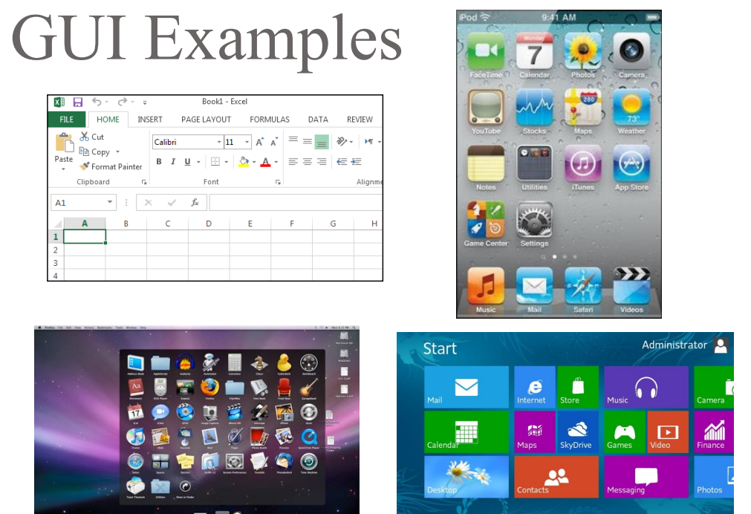
A GUI lets people interact using windows, controls and visuals.
JavaFX provides ready-made UI components for Java.
Today: move beyond console input and output.

Slide 4
Console program
JavaFX program
Enter your name: Amit
Enter marks: 85
Saved student: Amit
Name
Amit
Marks
85
Save
Sequential text-based interaction
Event-driven interaction

Slide 5
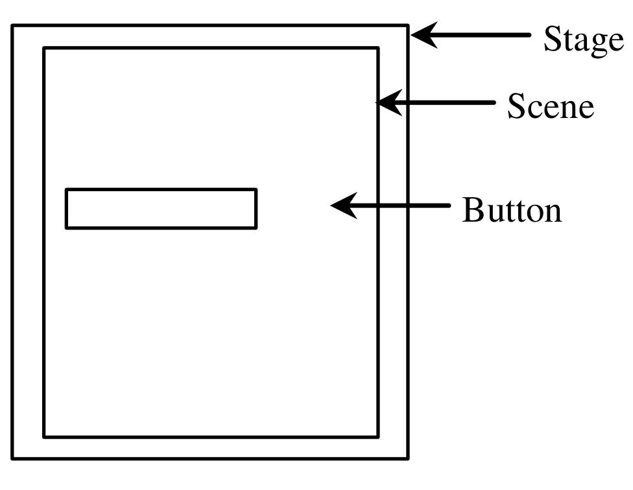
Stage, Scene and Nodes
Stage
The top-level application window.
Scene
The content held inside a Stage.
Node
A button, label, image, shape or layout.

Slide 6
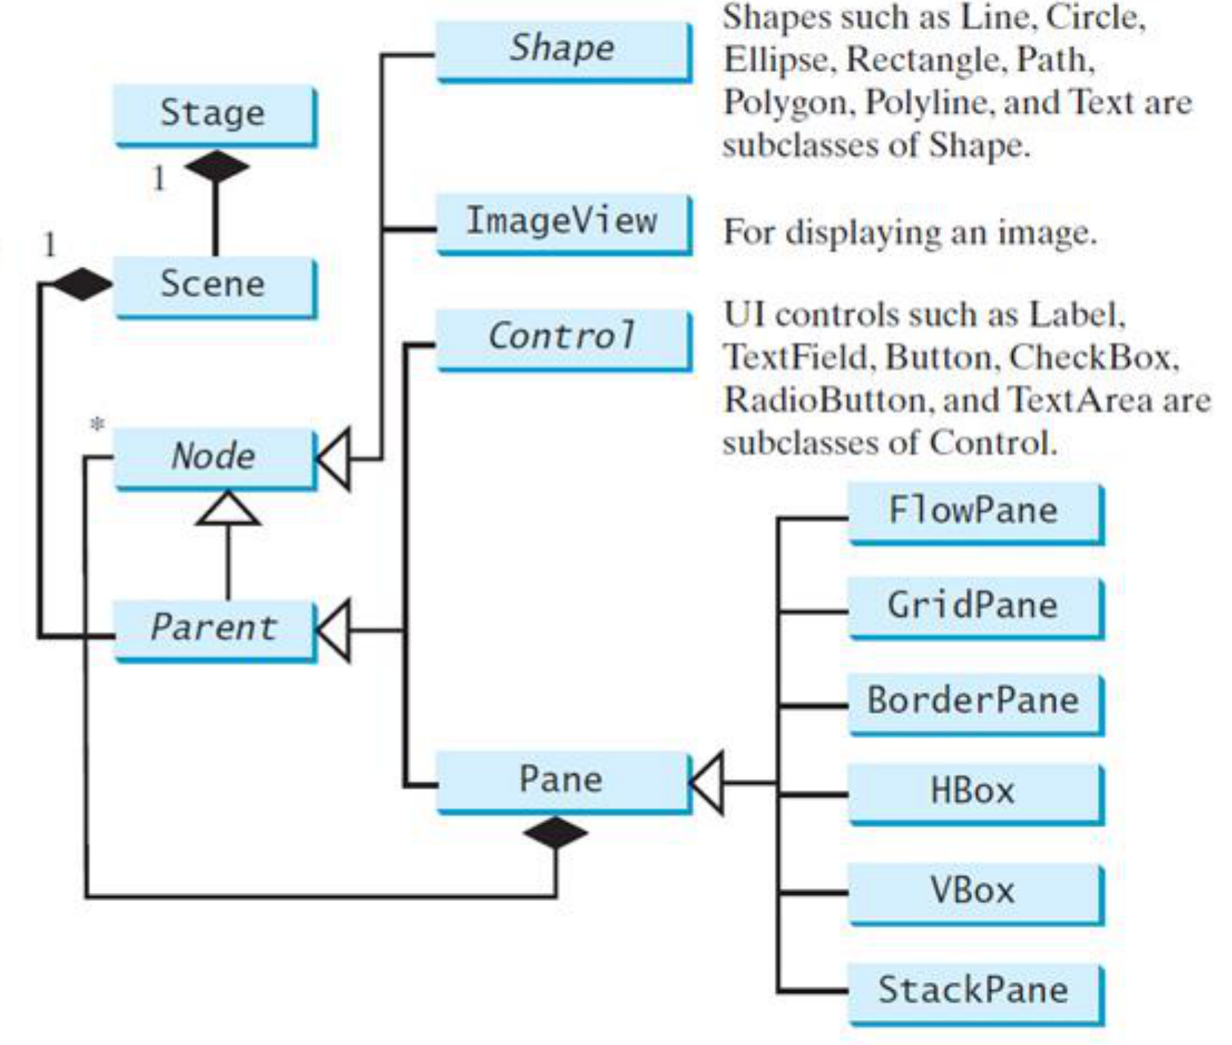
JavaFX offers more than buttons
javafx.application.Application is the entry point for JavaFX applications. JavaFX creates an application thread for running the application start method, processing input events, and running animation timelines. We override the start(Stage) method!
javafx.stage.Stage is the top level JavaFX container (i.e., window). The primary Stage is constructed by the platform. javafx.scene.Scene class is the container for all content in a scene graph in the stage.
javafx.scene.Node is the base class for scene graph nodes (i.e., components).

Slide 7
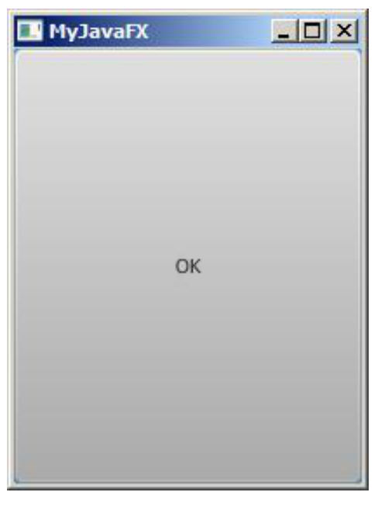
Simple button creation
import javafx.application.Application;
import javafx.stage.Stage;
import javafx.scene.Scene;
import javafx.scene.control.Button;
public class MyFirstJavaFX extends Application {
@Override // Override the start method in the Application class
public void start(Stage primaryStage) {
// Create a button and place it in the scene
Button btOK = new Button("OK");
Scene scene = new Scene(btOK, 200, 250);
primaryStage.setScene(scene); // Place the scene in the stage
primaryStage.setTitle("MyJavaFX"); // Set the stage title
primaryStage.show(); // Display the stage
}
public static void main(String[] args) {
launch(args);
}
}

Slide 8
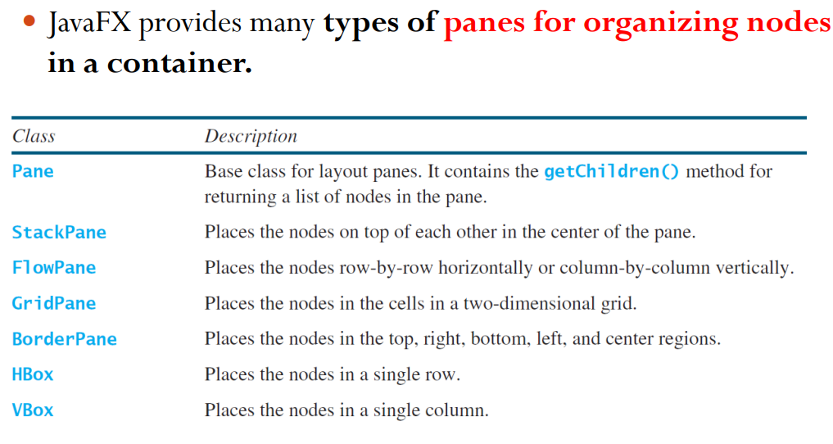

Slide 9
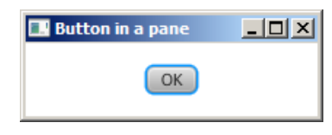
import javafx.application.Application;
import javafx.stage.Stage;
import javafx.scene.Scene;
import javafx.scene.layout.StackPane; //added newly
import javafx.scene.control.Button;
public class ButtonInPane extends Application {@Override // Override the start method in the Application class
public void start(Stage primaryStage) {
// Create a scene and place a button in the scene
StackPane pane = new StackPane();
pane.getChildren().add(new Button("OK"));
Scene scene = new Scene(pane, 200, 50);
primaryStage.setTitle("Button in a pane"); // Set the stage title
primaryStage.setScene(scene); // Place the scene in the stage
primaryStage.show(); // Display the stage
}
public static void main(String[] args) {
launch(args);
}
}

Slide 10
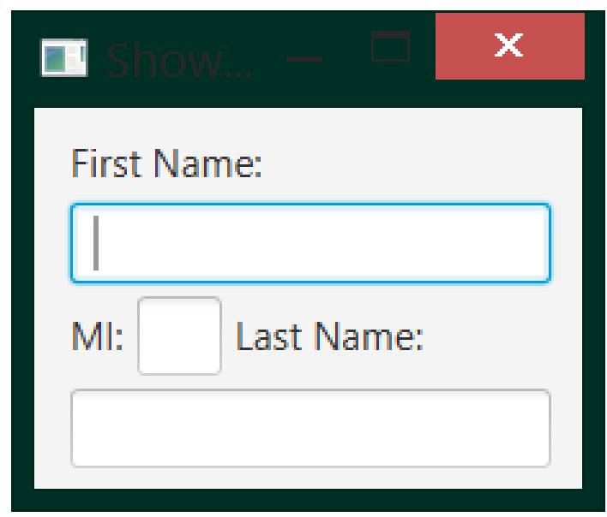
FlowPane
FlowPane pane = new FlowPane();
pane.setHgap(6);
pane.setVgap(6);
pane.getChildren().addAll(
new Label("First name"), new TextField(),
new Label("Last name"), new TextField()
);

Slide 11
Now add persistence
So far
User can click, type and see changes.
Store the same data in MySQL.
Data disappears when the app closes.
Retrieve it when the app starts again.

Slide 12
SQL provides four basic operations
INSERT
SELECT
Create a new record
Read existing records
UPDATE
DELETE
Change existing records
Remove records
SELECT name, marks FROM students;
INSERT INTO students(name,email,marks)
VALUES ('Amit', 'amit@example.com', 85);

Slide 13
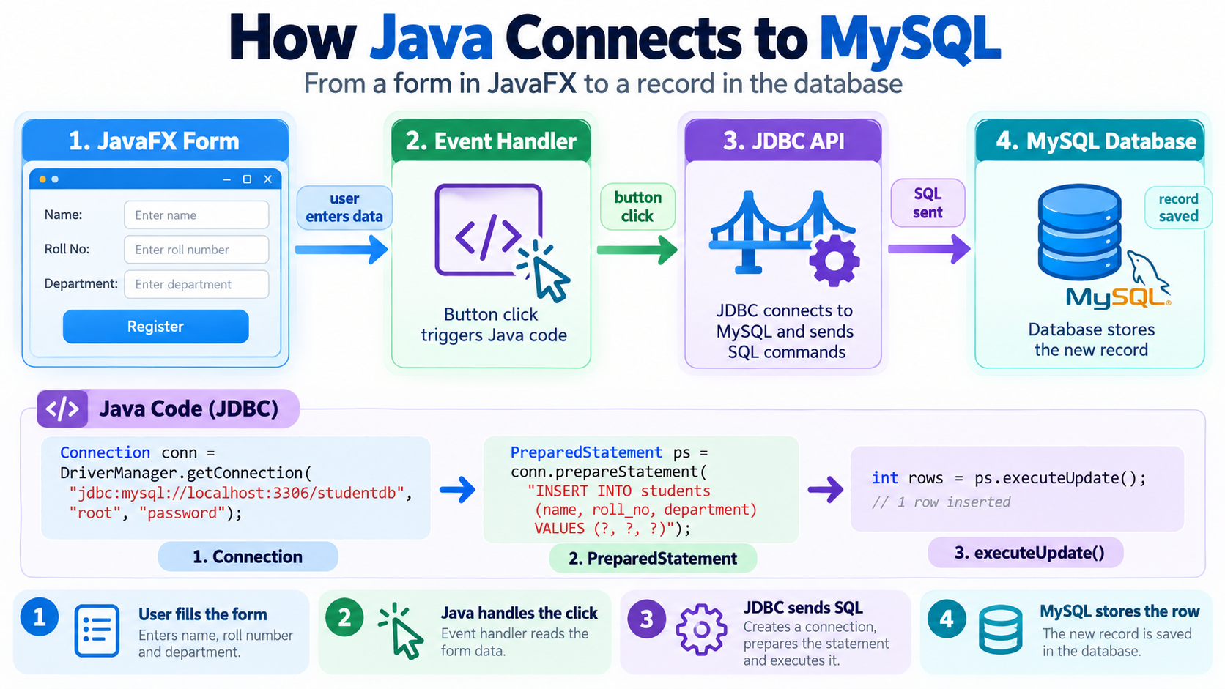

Slide 14
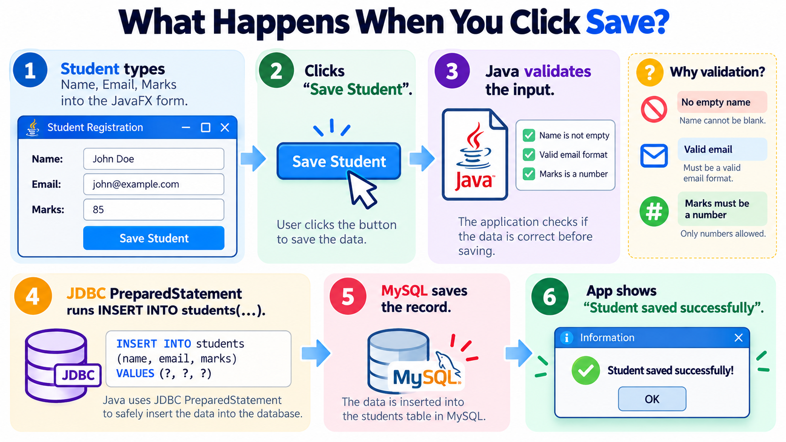

Slide 15
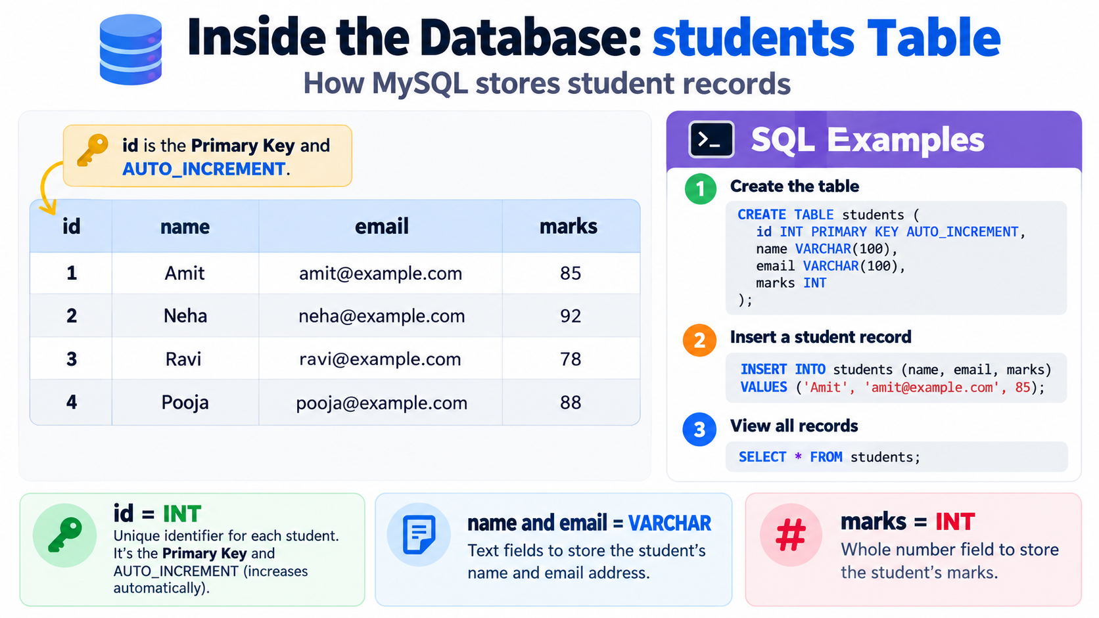

Slide 16
Step 1: open a database connection
String url = "jdbc:mysql://localhost:3306/studentdb";
String user = System.getenv("DB_USER");
String password = System.getenv("DB_PASSWORD");
try (Connection con = DriverManager.getConnection(
url, user, password)) {
System.out.println("Connected!");
}

Slide 17
Step 2: save data safely
String sql =
"INSERT INTO students(name, email, marks) VALUES (?, ?, ?)";
try (PreparedStatement ps = con.prepareStatement(sql)) {
ps.setString(1, name);
ps.setString(2, email);
ps.setInt(3, marks);
ps.executeUpdate();
}
The ? placeholders separate user data from SQL syntax.

Slide 18
Step 3: retrieve records
String sql = "SELECT name, marks FROM students";
try (PreparedStatement ps = con.prepareStatement(sql);
ResultSet rs = ps.executeQuery()) {
while (rs.next()) {
System.out.println(rs.getString("name")
+ " : " + rs.getInt("marks"));
}
}

Slide 19
Build an application

Slide 20
Create studentdb
CREATE DATABASE IF NOT EXISTS studentdb;
USE studentdb;
CREATE TABLE IF NOT EXISTS students (
id INT AUTO_INCREMENT PRIMARY KEY,
name VARCHAR(100) NOT NULL,
email VARCHAR(150) NOT NULL UNIQUE,
marks INT NOT NULL
);

Slide 21
Build the GUI
TextField name = new TextField();
TextField email = new TextField();
TextField marks = new TextField();
Button save = new Button("Save Student");
VBox root = new VBox(10,
new Label("Name"), name,
new Label("Email"), email,
new Label("Marks"), marks, save);
Student Registration
Name
Email
Marks
Save Student

Slide 22
Respond and persist
save.setOnAction(event -> {
String n = name.getText().trim();
String e = email.getText().trim();
int m = Integer.parseInt(marks.getText());
try {
repository.save(n, e, m);
status.setText("Student saved");
} catch (SQLException ex) {
status.setText(ex.getMessage());
}
});

Slide 23
Thank You
github.com/junaidjmomin

